Slide 1
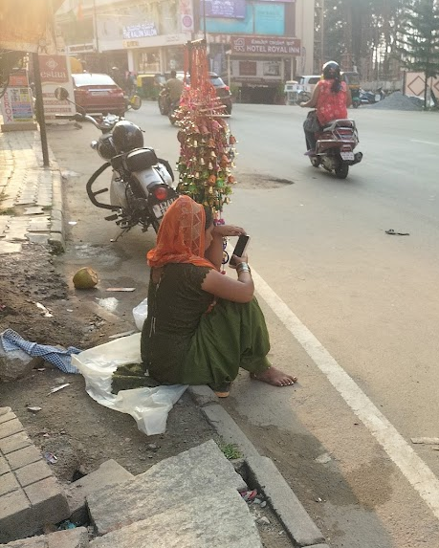
Exploring Women Vendors’ Degrees of Use of Smartphones
Akanksha, Khushi & Sookthi

Slide 2
Introduction: Why this topic?
Started out
Moved
Reasons
Curiosity to study how people navigate data use and purchase decisions with income constraints
Moved to the topic of women shopkeepers and street vendors.
UPI adoption and data availability makes smartphones common, Vendors and their public use of mobile phones

Slide 3
Research Questions
Q. How do women vendors navigate use with limited data?
Q. How do women vendors use their mobile phones for leisure?
Q. Does their usage change when they go home? How do gender and family dynamics influence their phone use?

Slide 4
Researcher Positionalities
Women
Privileged class, no firsthand experience with daily-wage work
Sookthi
Khushi
Akanksha
Hindi-speaking
Familiar with the city’s commercial areas
Kannada-speaking
Background in Science
Coed
Background in Social Sciences
All women’s college

Slide 5
Methodology
Identification of four commercial locations in Bengaluru:
Jayanagar: Mostly established area with registered, local vendors
Neeladri Road: New commercial area, a mix of Tamil and Rajasthani vendors, all unregistered stalls
Church Street: Upgraded area with unregistered vendors.
Commercial Street: Established commercial area with registered vendors from different demographic backgrounds.

Slide 6
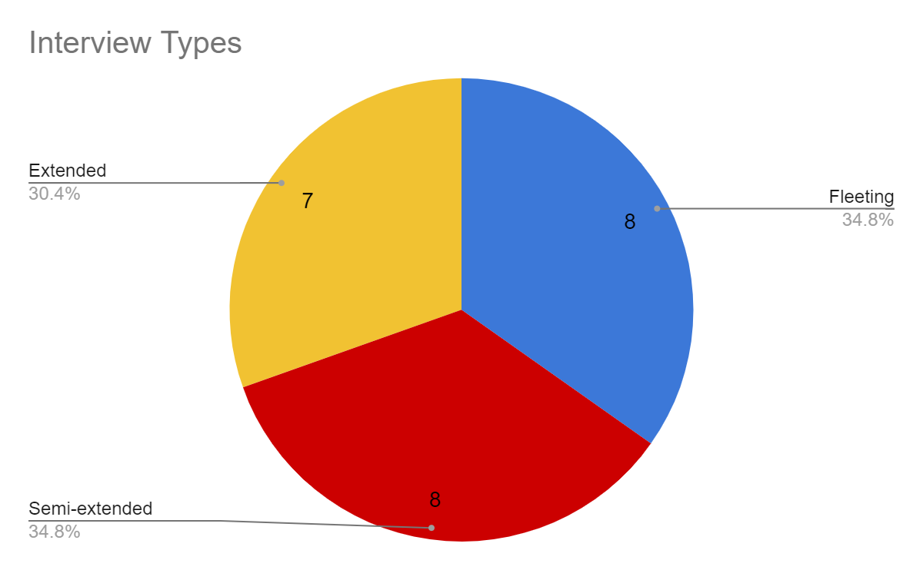
Methodology
Semi-structured interviews done during a three-week span in September and October.
Recruitment of participants through convenience sampling.
Non-participant observations
Interviews of three durations:
Fleeting: below 5 minutes
Semi-extended: between 5 - 10 minutes
Extended: Above 10 minutes in length

Slide 7
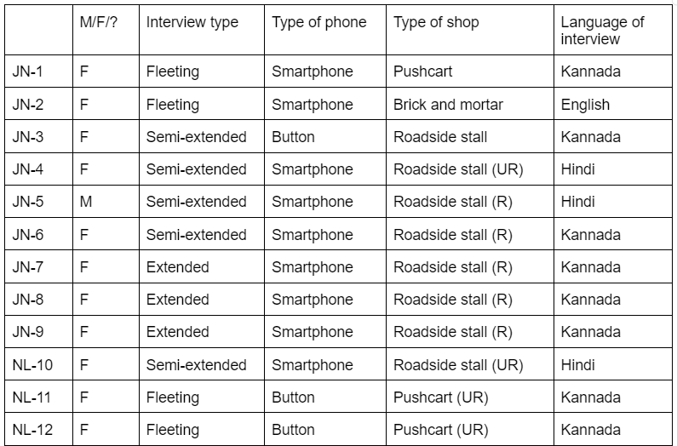
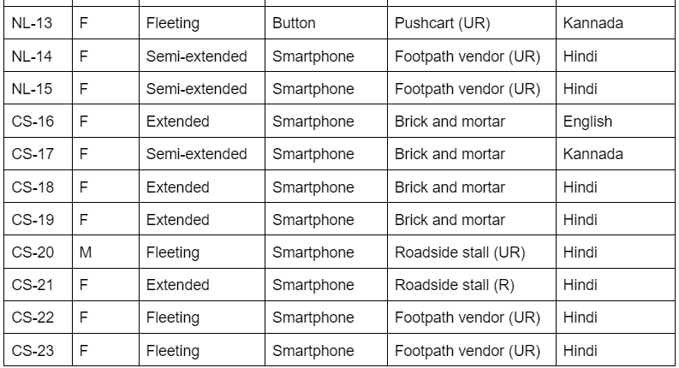
Interview Participants
Registration: 11 R, 11 UR, 1 ND
Phone: 19 Smartphones, 4 Button/Keypad Phones
Purpose: Sharechat, TikTok, YouTube, Instagram, downloaded movies, Google Maps, WhatsApp

Slide 8
Limitations
In hindsight, convenience sampling was not ideal for our research study. Limited rapport and interview depth, led to short and data-poor interviews.
We couldn’t go back for follow-up questions after analysing transcripts.
Nature of their work prevented us from asking too many follow-up questions.
Our own learning curve: initial interviews gave poorer data, since we didn’t know how to ask the right questions.

Slide 9
Findings
Perceptions of non-use
Mediated use and decision-making
Family dynamics
Work and leisure: blurred boundaries

Slide 10
1.Perceptions of Non-Use
Non-Use and Dislike
Self- Perception-
Idea that to use a phone you need to be educated
Digital Literacy/Discomfort with technology

Slide 11
Perceptions of Non-Use
Non-Use and Dislike
‘I like watching serials in my free time. But I watch it on TV. I don’t need a phone.’
- NL12
All women interviewed who had keypad phones claimed that they did not like using smartphones. (JN3, NL11, NL12, NL13)
Their male family members usually had smartphones, but they wouldn’t use them.
Both lack of digital literacy and lack of need
‘I just don’t like it… I don’t like phones. I have just a button phone. My brothers have a smartphone, but I don’t like to use it.’ - NL12
‘My husband has a phone. Children also have… I don’t like to use phones. Whether they show or don’t show, I don’t like it. I don’t know how to use also. ’ - NL11

Slide 12
Perceptions of Non-Use
Non-Use and Dislike
JN3 also a women who has keypad phone claiming that she don’t like smart phone
When asked whether she likes when her daughter-in-law show her something in her phone, she said yes.
‘Dislike’ may also reveal other reasons for non-use
‘Yes, sometimes she shows. But not much. I don’t see it. It’s just time waste, I don’t have any use for it.’
‘Yeah, yeah (I like) … Can’t ask my daughter-in-law for her phone whenever I want’
- JN3

Slide 13
Perceptions of Non-Use
Self-Perception
There is a perception that if person have studied they are more free and can do anything.
‘When they are free, they like to use the mobile phone and go wherever they want. It brings a lot of joy. But it is only for those who have studied. My daughter takes her phone, goes outside, with a lot of freedom she goes around, explores new places, and so on. She can make phone calls.’ - JN8
‘ Do you use UPI to pay other people, in shops and all?
No, madam, my daughter does it. I did it twice or thrice, and it didn’t work (‘miss aagoythu’), I didn’t know how to use it. I have not studied as much as them, I studied very less. That’s why they handle everything. - JN8

Slide 14
Perceptions of Non-Use
Digital Literacy / Discomfort with technology
‘I don’t go to the ATM, madam. These people (UPI market account) let us withdraw money from the account four times each month. If we take it five times, we have to pay a penalty of Rs. 80. If we withdraw more than five times, we have to pay Rs. 100. What can I do? Do I look at the Rs. 100? No, I can’t do that, so I just go for it. If I need it urgently, I go and take it. If I walk a bit, I reach the bank, in third block … It’s just a short distance from here - if you walk five minutes from here, just like you go to the restroom, you can go and get money.’ - JN8
Don’t like to use UPI, prefer to go to bank
‘No, madam, my daughter does it. I did it twice or thrice, and it didn’t work, I didn’t know how to use it. I have not studied as much as them, I studied very less. That’s why they handle everything.’- JN8

Slide 15
2. Decision-Making
‘Decision-making’: data pack recharge, content downloading viewing decisions
Decision-making is mediated by the ‘other’ – both people and financial criteria
Parts:
Decision making by adult children (mediated use)
Data recharge by others (mediated use)
Data recharge by self - decision-making criteria

Slide 16
Decision-Making
Decision Making by Adult Children
Women vendors with older children and grandchildren took their help to use their smartphones, to overcome their own difficulties with digital literacy
‘Data? The normal... My children put it for me, I see that, that’s all…I do find it difficult, but they (children) take care of everything. I just do ‘on-off’. If I want some song, I listen to it, I talk (to people), that’s all.’
- JN8
‘She (my daughter) downloads and gives me pictures (movies) to watch (while working).’ - JN9

Slide 17
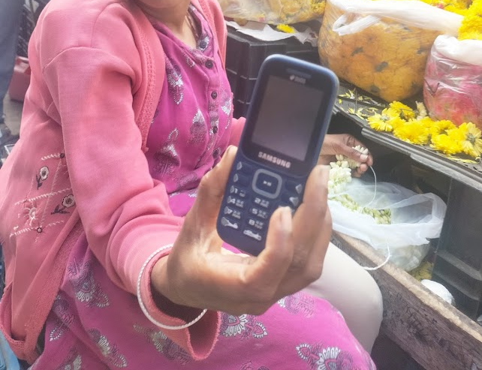
Decision-Making
Data Recharge: Others
6 women informed us that their plan recharge decisions were made by others.
Women who had keypad phones did not recharge their phones by themselves, UPI linked to husbands’ accounts.
‘’I have a button phone only. To recharge and add currency, my husband takes care of everything, I don’t do much.’
‘All scanning money goes to my husband’s phone... Husband’s account.’
- NL11

Slide 18
Decision-Making
Data Recharge: Self
13 women recharged the datapacks of their own phones. Only 1 of them recharged in-app, the rest preferred doing it in-person at a shop.
Spending decision was based on their monthly savings: usually 1 or 3 month plans.
‘Whatever money I get, I have to spend it on these materials, for my household expenses. After that, if I still have 2000-3000 Rupees in my account, then I purchase a three-month plan. If that month my budget is low, then I buy only a one-month or twenty-eight-day plan.’ - JN9
‘We all take only the 1-month pack for data and currency … We recharge once it gets over only, don’t know when our phone will get spoiled. Don’t want to take more.’ - JN1

Slide 19
Decision-Making
Data Recharge: Self
‘One or two months I do it like that only, I keep switching between plans. I can’t predict, right? If [inaudible] comes, I have to spend Rs. 1000, and if these other things come… current bill…now they have made current bill free, but before if I had to spend on current, I would have to spend Rs. 500. If some child falls sick, that amount I’ll spend for them. Then, whatever money I get next month, I’ll use that accordingly for data.’
JN9

Slide 20
3. Family Dynamics and Phone Usage
We see that family dynamics, often gendered, affect

Slide 21
Family Dynamics and Phone Use
Family Dynamics In Phone Use
For women who are not digitally literate, relying on children and in-laws is essential.
JN3 has a keypad phone, but scrolls through phones of customers’, kept for charging at her stall. She cannot use the smartphone at home freely.
Family gendered control over phone use also influence how women choose to use their phones
‘Yeah yeah (I like seeing things on phone) but…can’t ask my daughter-in-law for her phone whenever I want.’ - JN3
‘They scold me if I use it (at home) because we should not use mobile much in front of bhaiya (brother) and papa (father).’ - JN4

Slide 22
Family Dynamics and Phone Use
Vendors as Mothers
Upon being asked if her current data plan is sufficient for her:
‘But if children use it, the data will not be enough. But children should not use more, no? That's why one day of data is enough for us... I don't put full data, because I cannot use it up.’
- CS15
Negotiate between allowing their children to use their phones, and restricting them from extensive use.
Women subscribe to low-data daily plans on purpose and use up the data at work, in order to ensure that their children don’t get too much data after they return from work.

Slide 23
4.WORK AND LEISURE- BLURRED BOUNDARIES
Phone use by others around women vendors workplace (customers/nearby standing people)
Phone use by women vendors at workplace
-Enacting religion at workplace
-Downloading movies at workplace
-Entertainment at workplace
-Leisure and work enabling each other
Hesitance to admit leisure

Slide 24
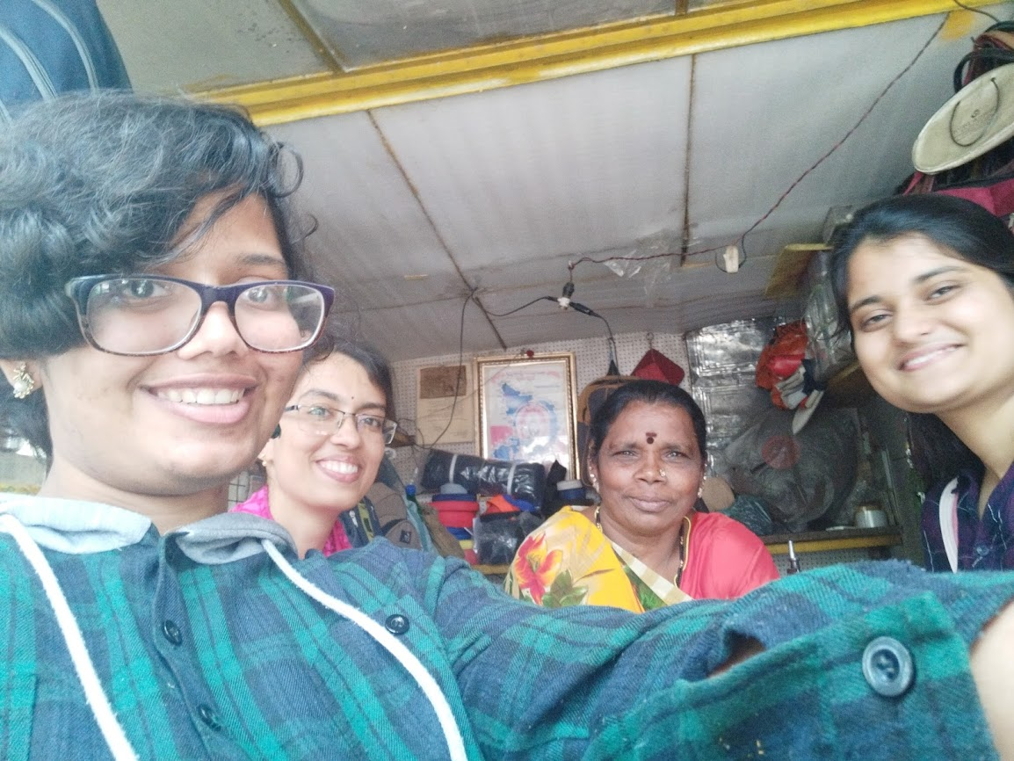
Work and Leisure - Blurred boundaries
Phone usage by others around women vendors’ workplace
. ‘Sometimes customers come to my shop and just stand and talk on their phones. I don’t know whether to work, eat food, or talk.’ - JN3

Slide 25
Work and Leisure - Blurred Boundaries
Phone use by women vendors at workplace
Q. ‘So if customers don't come, do you look at the phone?’
18: ‘The phone is there. If they don't come, we'll listen to the message for a while.’
19: ‘We'll look at cooking videos in it.’
- CS 18, 19
Enacting religion at workplace

Slide 26
Work and Leisure - Blurred Boundaries
Phone use by women vendors at workplace
‘I download movies using WiFi, and later I watch it after work.’ - CS21
Downloading movies at workplace

Slide 27
Work and Leisure - Blurred Boundaries
Phone use by women vendors at workplace
Q: ‘Do you use your phone for entertainment purpose here?
10: ‘Yes, to listen to music.’
Q: ‘From where do you listen to songs? YouTube?’
10: ‘No, my brother downloads it and I just listen to that.’ - NL10
‘In Sharechat you can see everything. Videos, TikTok, everything. I use it for timepass, when others are not around’ -JN1
Entertainment at workplace

Slide 28
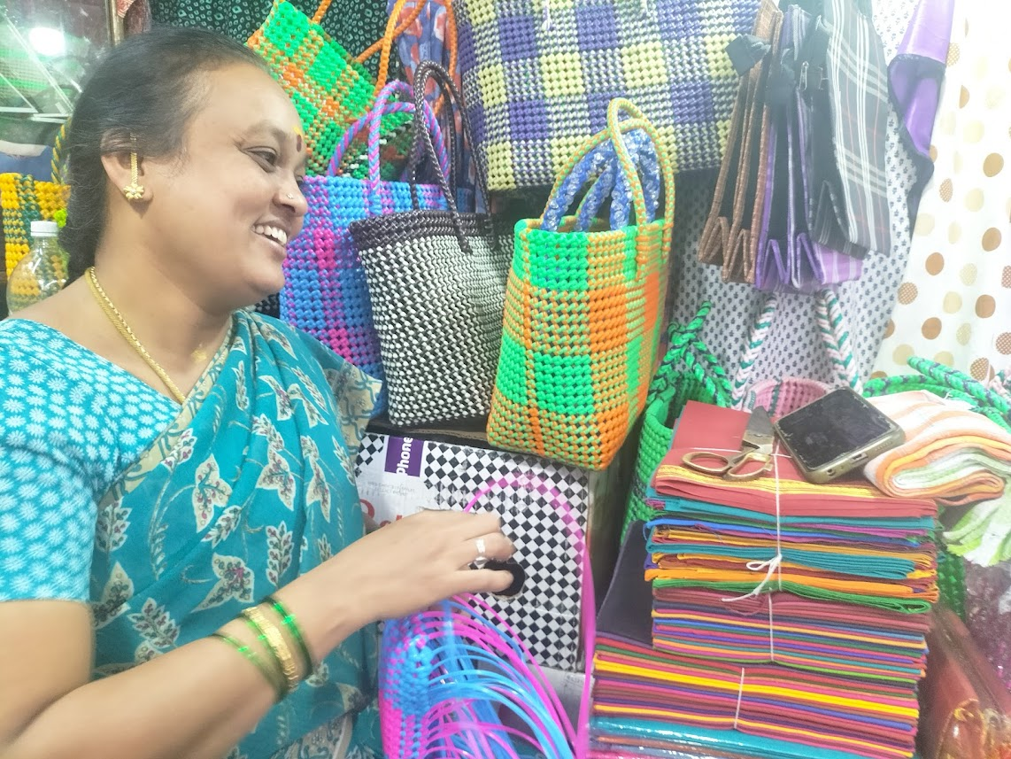
Work and Leisure - Blurred Boundaries
Phone use by women vendors at workplace
‘As I do this work (basket-weaving), I start thinking about all these problems… my mind becomes black. When that happens, if I want some enjoyment, I keep my phone in front of me and smile sometimes, laugh sometimes, cry sometimes (gestures crying) - when I watch some shows, I tear up. Now all of this is available inside the phone, in the dramas you watch’. - JN9
Leisure activity and work enabling each other

Slide 29
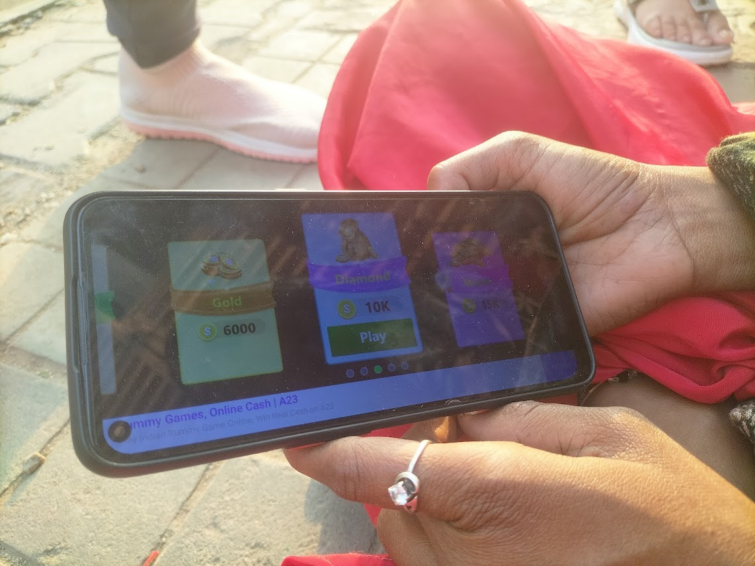
Work and Leisure - Blurred Boundaries
Hesitance to admit leisure (NL-14)
This woman was playing some game on her phone when we approached her. As we did she had this reflex that made it seem like she wanted to close off the game she was playing, but she hesitantly showed us the screen as we were well in time. After shutting her phone she agreed to talk to us and answered our questions. Although from her mannerisms it was obvious that she loved using the phone and was playing games.etc but later in the interview, she mentioned that she does not like using her phone much and only uses it for necessities.

Slide 30
Discussion
Possessing a phone does not guarantee complete usage.
We see differences in the quality of use. When women are unable to use their phones ‘fully’ for work, they rely on others to guide them through those functionalities.
Satchell & Dourisch (2009): ‘Disenfranchisement’ as a form of non-use where certain social groups are excluded because of the nature of technology.
We observe: social arrangements may also lead to disenfranchisement - gendered family dynamics, access to education, etc.

Slide 31
Discussion
Self perception leading to non-use: The self-perception of women in regards to their capability to use the internet and other technologies – as women are often marginalized by their own beliefs which can be shaped by illiteracy and economic circumstances (Johnson, 2010).
Women vendors using phones blur boundaries between the public and private, work and leisure. They negotiate between their many role expectations.
Self use of mobile phones but also use of mobile phones by others blurs boundaries between public and private, work and leisure.

Slide 32
References
Johnson, V. (2010). Women and the Internet: A Micro Study in Chennai, India. Indian Journal of Gender Studies, 17(1), 151–163. https://doi.org/10.1177/097152150901700107
Satchell, C., & Dourish, P. (2009). Beyond the user: Use and non-use in HCI. Proceedings of the 21st Annual Conference of the Australian Computer-Human Interaction Special Interest Group: Design: Open 24/7, 9–16. https://doi.org/10.1145/1738826.1738829

